Slide 1
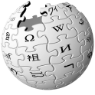
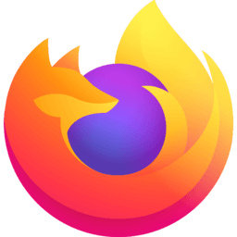
Internet meaning & Characteristics
Ganesh Kumar Ranjan
Faculty, MJMC,
MMHA&PU

Slide 2
The term ‘The Internet’ cover:
The interconnected and networked technological infrastructure that support the world wide web.
Proprietary sites linked into the web
Open and close source software and architecture
Computer and every day language in terms of making the internet accessible to people of many cultures and illiteracies.
Email, chat and instant messaging
Blog and social networking sites
Games, communities, environments and words
The many ways in which digitally mediated communication has become domesticated and pervasive within everyday.
Louvre Museum Official Website

Slide 3
Characteristics of Digital information
Japanese futurist and information scientist Yoneji Masuda (1981) has categorised four characteristics of digital information:
Information is not consumable
Information is non-transferable
Information is indivisible
Information is accumulative

Slide 4
Information is not consumable: It continues to exists after it has been used and different people can use the same information multiple times.

Slide 5
Information is non-transferable: This means that the information can be passed onto others and yet still be retained by the original user.

Slide 6
Information is indivisible: Every fourth letter-space punctuation in this PPT, for example fail to communicate a quota of meaning.

Slide 7
Information is accumulative: As information is used, for example entered into data base and then processed using statics software such as ‘P’ so it’s become more relevant and accessible for a range of people. Usually the processing of information makes it more useful; it adds value. This is because accumulation of goods is by their non-use, but information can not be consumed or transferred thus information is accumulated. So it has greater use and as it is being used so more information is accumulated.

